Slide 1
VISUAL COMPUTING AND MIXED REALITY
Assignment - 3
Naveena Katpally(101551664)
Shruthi Kura(101516439)

Slide 2
Problem
To implement an Augmented Reality(AR) application

Slide 3
Introduction
Designed an AR application in unity3D with vuforia.
Created our own markers.
Rendered the virtual objects on the markers along with its animations.

Slide 4
Steps to create AR marker:
Target Manager
Create Database
Add Target
Upload image
Download database
AR camera →Activate the database
Vuforia→ prefabs→drag the image target on the scene
Change dataset from empty to our database

Slide 5
Steps to Render virtual objects:
Download 3D model from assets store and import it.
Set the object positions, rotations and scaling
Drag the object on to the marker from assets
If any animations
Perform animation operations

Slide 6
Issues:
Faced an issue during the creation of markers.
Issues while setting the object positions, rotation and scaling

Slide 7
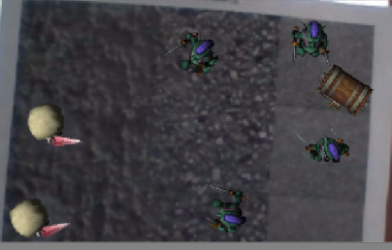
Output
Output using marker1:

Slide 8
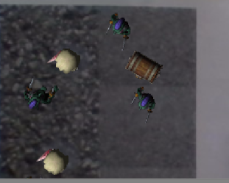
Output using marker2:

Slide 9
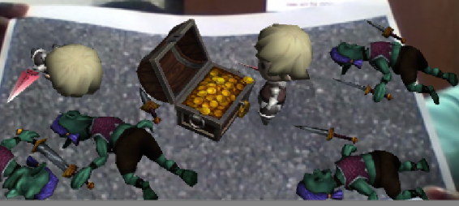
Output using marker3:

Slide 10
Any Questions???

